Slide 1

Bootcamp
Dibimbing.id
Python:
Regression with Regularization

Slide 2








PT Cakra Syntesis Indonesia
Android Developer (2016)
Nawatech
Jr. ML Engineer (2017)
Bukalapak
Data Scientist (2018 - 2020)
Data Scientist Instructor
(Sept 2020 - Nov2020)
Data Scientist Instructor
(2021 - 2021)
Evermos
Sr. Data Scientist - Data Lead
(2021 - present)
Data Scientist Instructor
(2021- present)
Trainer Bio
Arif Romadhan
Linkedin : https://www.linkedin.com/in/arif-romadhan19/

Slide 3

Outline
Bias-Variance Trade-Off in ML Models
Regularization in Linear Regression
Ridge Regression
LASSO
Choosing the best regularization parameter
Assignment

Slide 4
Bias & Variance in ML Models
01
02
Bias
Variance
Model systematically deviates from the true data pattern
i.e. discrepancy between average model prediction and ground truth
High bias is usually associated with underfitting
Variability in the model prediction
i.e. small change on the data, leads to significant change on the model output
High variance is usually associated with overfitting

Slide 5
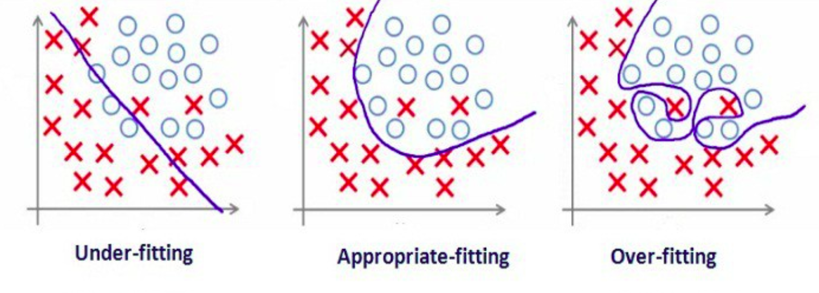
Underfitting
Overfitting
Overly-simplified model
Indication: high error (evaluation metrics) on both train and test data
Overly-complex model
Start modeling the noise, instead of the true pattern of the data
Indication: low training error, high test error

Slide 6
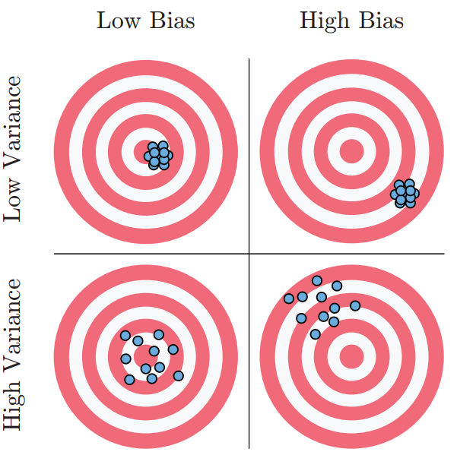
Bias & Variance Illustration
Remember the concepts via dart board pictures

Slide 7
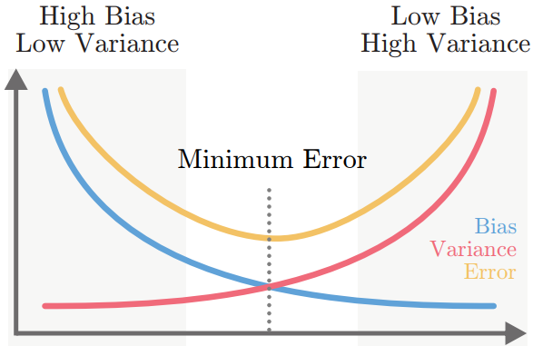
Bias-Variance Trade-Off
We want the sweet-spot between the two
3 sources of model error
Bias
Variance
Irreducible error (inherent noise)
Simple model
Complex model

Slide 8
Bias-Variance Trade-Off
We want the sweet-spot between the two
3 sources of model error
Bias
Variance
Irreducible error (inherent noise)
Therefore, we can
reduce bias by increasing variance
E.g. use more complex model
reduce variance by increasing bias
E.g. use simpler model, including model with regularization
The ideal state is to find the balance between bias and variance → minimum model error
Simple model
Complex model

Slide 9
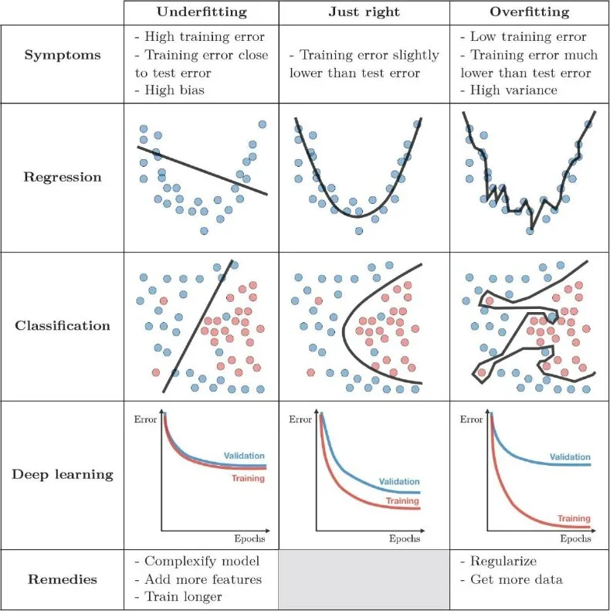
General Impact di setiap kasus

Slide 10


Slide 11

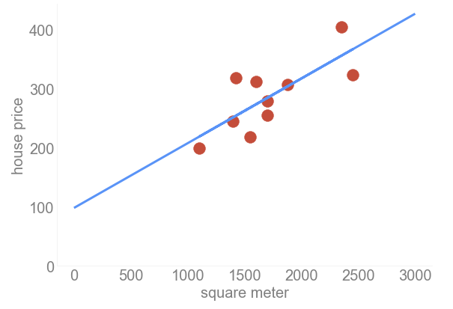

Simple Linear Regression
Slope
= 0.1098
Intercept
= 98.2483

Slide 12
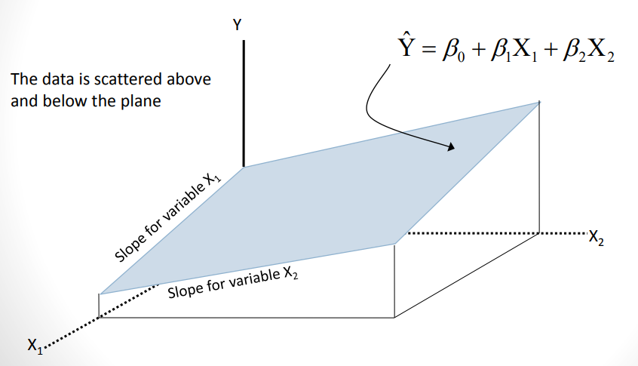
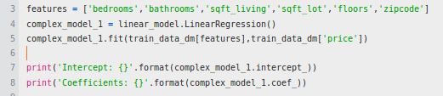
Multivariate Linear Regression
Kalau di 2D, kita mengenal istilah garis, di lebih dari 2D, kita menggunakan istilah plane
Data point tersebar diatas atau dibawah plane yang terbentuk

Slide 13
Sebuah kasus:
Bagaimana jika kita hanya mempunyai sedikit data untuk training?

Slide 14
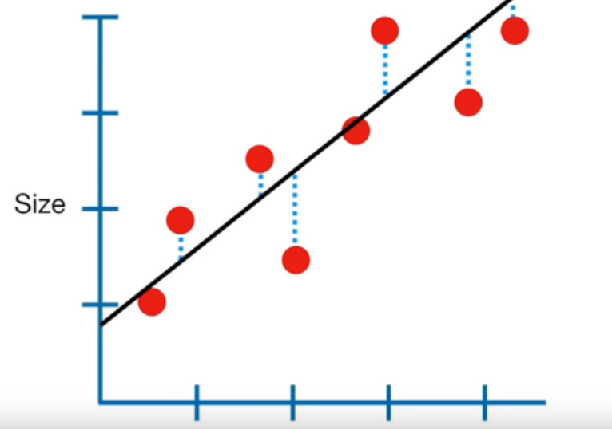
Untuk mengingat, ini adalah hasil dari Linear Regresi
Weight

Slide 15
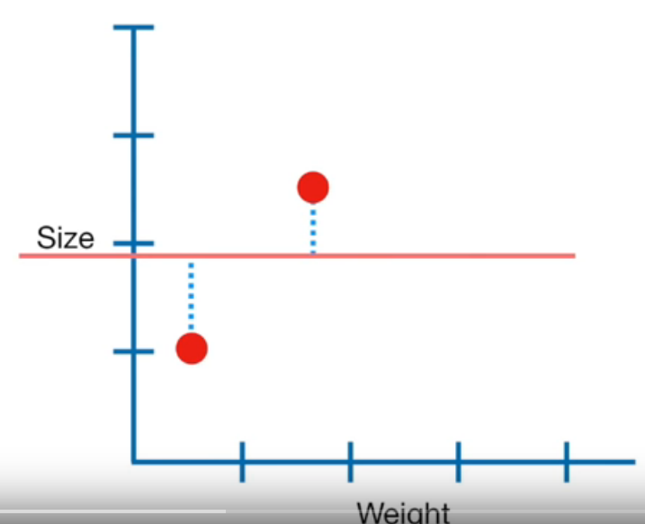
Nah, bagaimana jika kita hanya mempunyai 2 data point saja untuk membuat garis linear?
Weight

Slide 16
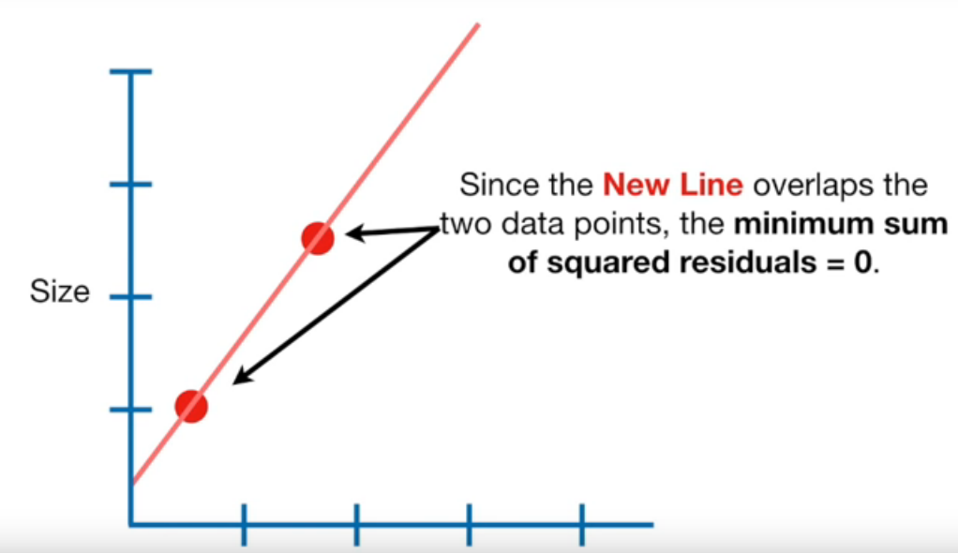
Nah, bagaimana jika kita hanya mempunyai 2 data point saja untuk membuat garis linear?
Garis linear yang baru overlap pada kedua data point yang ada. sehingga total jaraknya = 0.
sounds good in the first place, huh?
Weight

Slide 17
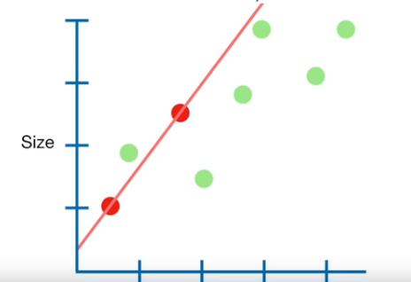
Jika data point merah adalah data training, dan
data point hijau adalah data testing,
Total jarak antara 2 data point pada data training sangat kecil, pada kasus ini adalah 0
Weight

Slide 18
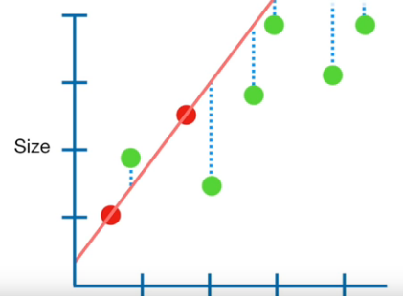
Jika data point merah adalah data training, dan
data point hijau adalah data testing,
Namun, total jarak pada data testing terlihat cukup besar, benar?
Weight

Slide 19
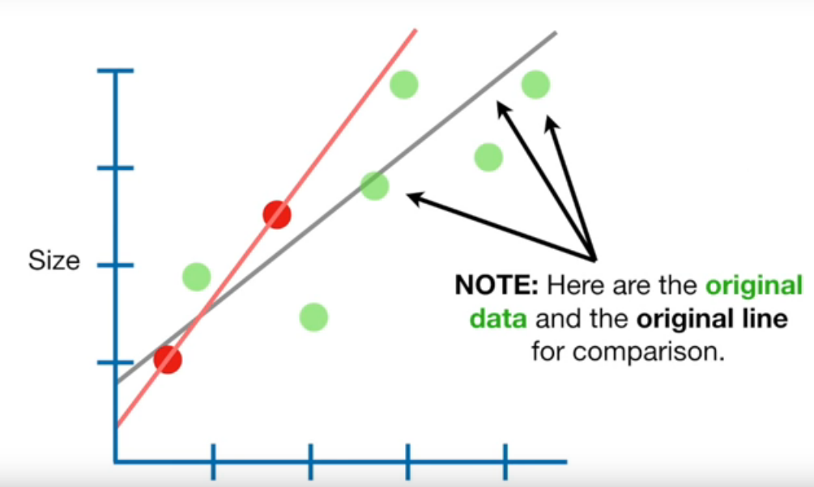
Bandingkan dengan garis linear yang awal
Data point yang berwarna hijau adalah data asli seperti sebelumnya. Untuk membandingkan dengan hasil sebelumnya, garis hitam menandakan hasil linear regression pada data asli
Weight

Slide 20
Untuk mengatasi hal tersebut, kita dapat menggunakan regularization.
Ada beberapa metode, yang akan dibahas pada materi ini adalah
Ridge & Lasso

Slide 21
Regularization in Linear Regression
Regularization (penalization):
Make the model more regular/simple
By shrinking the model coefficients towards zero
I.e. coefficients with smaller absolute values
Objective:
To reduce model variance, by (slightly) increasing the model bias
Ultimately, to address overfitting

Slide 22
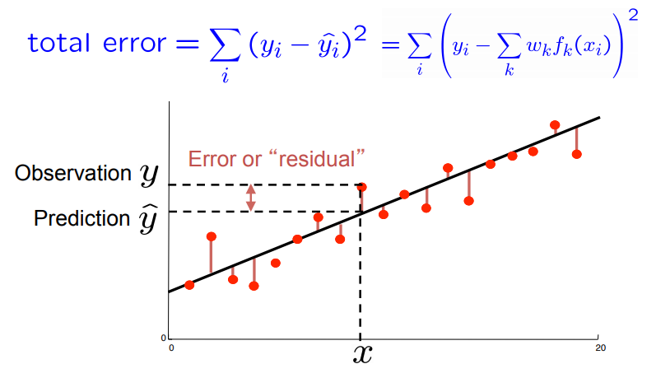
Objective/Loss Function
RECAP
The magnitude we want to minimize when training the model
Residual: delta between the real target variable y and the predicted target variable y_{hat}
Predicted values = regression line
Train the model to minimize: Residual sum of squares
red points are our data points
black line is the regression line (our prediction values)

Slide 23
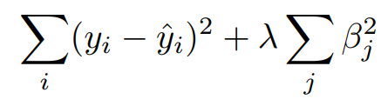
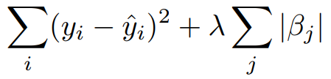
Ridge
LASSO
Linear regression with modified loss function
Where lambda is non-negative regularization parameter
Larger == heavier regularization
0 == ordinary linear regression
Effect to the model coefficients (beta)
Beta will become smaller (larger lambda == smaller beta)
Yet they all never be exactly zero
Linear regression with modified loss function
Where lambda is non-negative regularization parameter
Larger == heavier regularization
0 == ordinary linear regression
Effect to the model coefficients (beta)
Beta will become smaller (larger lambda == smaller beta)
Some of them will be exactly zero (eliminated from the model)
LASSO: Least Absolute Shrinkage and Selection Operator

Slide 24
Multivariate Linear Regression
Kalau di 2D, kita mengenal istilah garis, di lebih dari 2D, kita menggunakan istilah plane
Data point tersebar diatas atau dibawah plane yang terbentuk

Slide 25
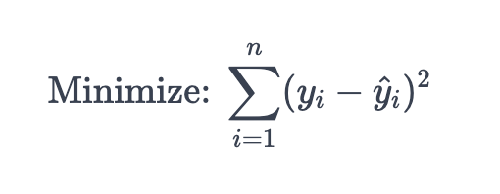
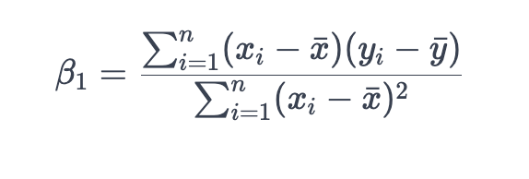
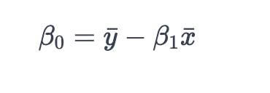
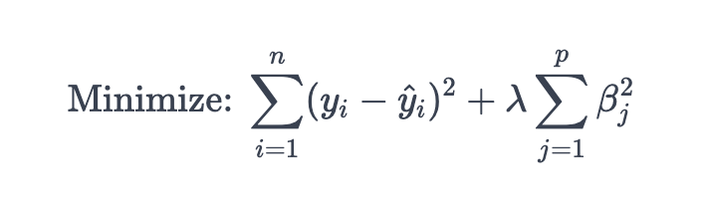
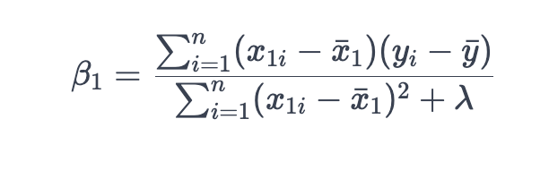
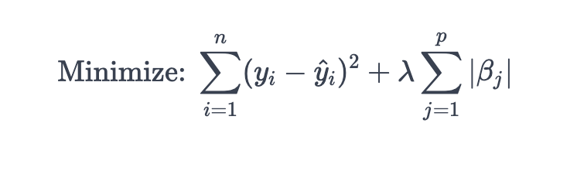
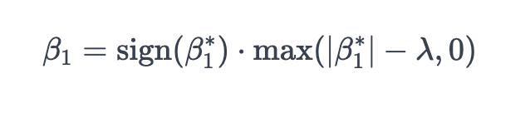
Linear Regression
Ridge Regression
Lasso Regression
Metode
Cost Function
Slope
Intercept
B1 = 2, L = 2
B1 - L = 2-2 = 0
B1 = 2, L = 1
2-1 = 1 => max(1,0) = 1
B1 = 2
sign(b1) = 1
sign(b1) *max(1,0)
= 1*1
= 1

Slide 26
Linear Regression
Ridge Regression
Lasso Regression
Metode
Cost Function
Slope
Intercept

Slide 27
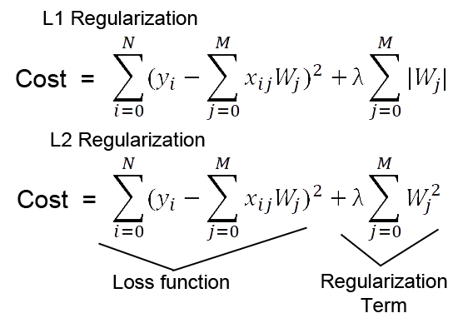
Notasi lain pada formula
LASSO
Ridge
Notes:
https://medium.com/@mukulranjan/how-does-lasso-regression-l1-encourage-zero-coefficients-but-not-the-l2-20e4893cba5d
https://medium.datadriveninvestor.com/linear-regression-35f8a65d83b9

Slide 28
Sebuah kasus:
Bagaimana mendapatkan nilai alpha/lambda yang optimal?

Slide 29
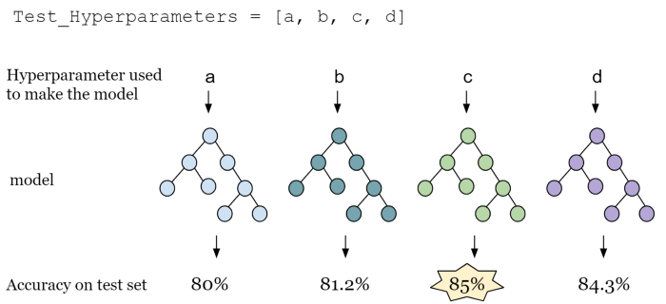
Hyperparameter mempengaruhi hasil

Slide 30
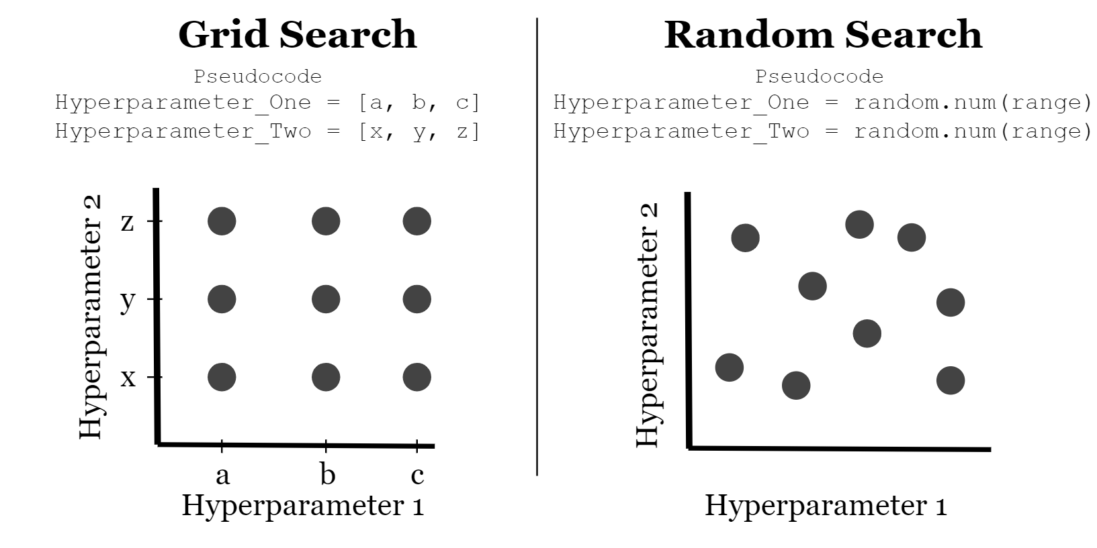
Solusi Umum: Grid Search

Slide 32
1
Split the data
80 : 20 is fine
2
Multicollinearity check
Calculate VIF score for each feature
Correlation analysis to drop redundant feature
Modeling Flow:
Regularized Regression
Fit the model on training data
3
Define and fit Lasso() or Ridge()
Only include retained features from step 2
4
Model diagnostic
Residual plot
R2 score on training data
No need QQ-plot
Not assuming normally distributed residuals
5
Evaluate the model on test data
RMSE
MAE
MAPE

Slide 33
The Data Used
For the rest of the lecture, we will regression_data.csv
The data is about university admit probability, based on several applicant’s features
GRE score
TOEFL score
University ranking
Motivation letter quality
Recommendation letter strength
GPA
Research experience

Slide 34
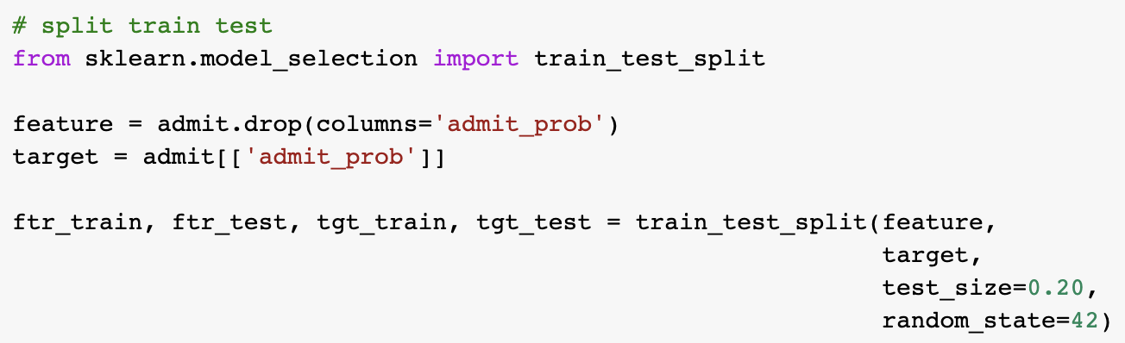
Split the Data
Using train_test_split() function
Recall, we want to predict admit_prob

Slide 35
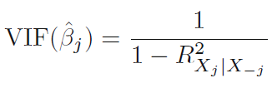
Multicollinearity (1/2)
Variance Inflation Factor
Multicollinearity: when two or more features/predictors are highly correlated each other
This can cause coefficients of estimates become unreliable
i.e. little change in the training data leads to completely different learned coefficients
We can detect this by computing Variance Inflation Factor (VIF) for each feature
On a high level: VIF feature j will be high if j can be predicted using the rest of other features. Vice versa
VIF == 1 → No multicollinearity
VIF between 4 and 10 → Moderate multicollinearity
VIF > 10 → Severe multicollinearity

Slide 36
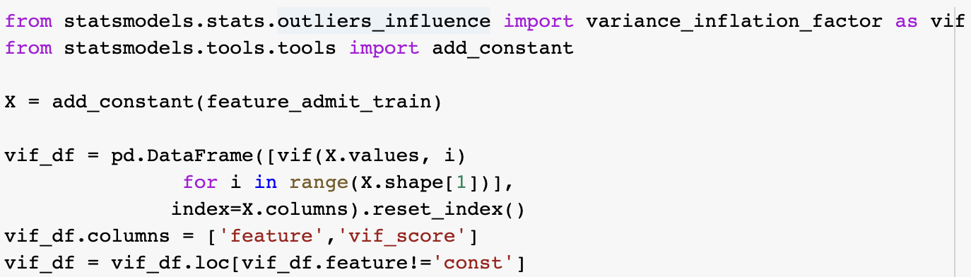
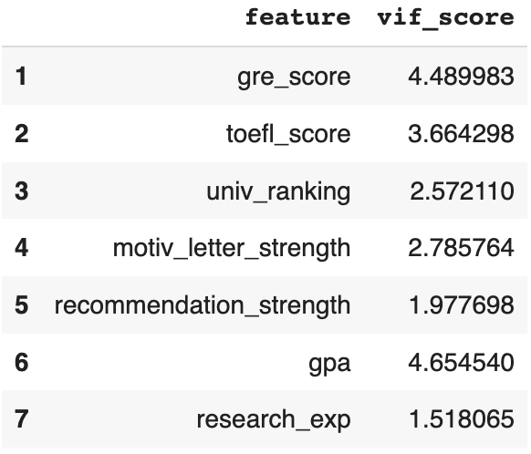
Multicollinearity (2/2)
Using statsmodels library

Slide 37
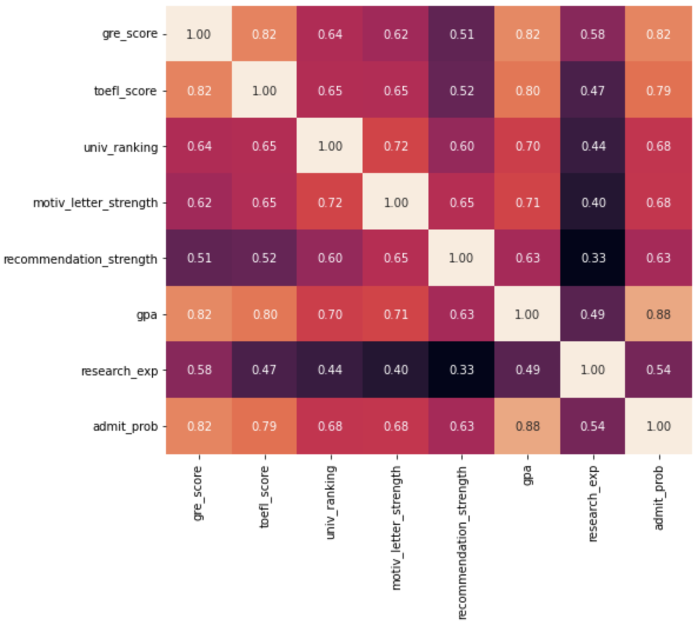
Feature Correlation
To prevent multicollinearity
We can draw a correlation heatmap
Using sns.heatmap()
We found that gre_score, toefl_score, and gpa are highly correlated each other
We decide to include only gpa to represent these three features
Because it is the most correlated with the target variable
Note: Threshold: abs(corr) >= 0.8

Slide 38
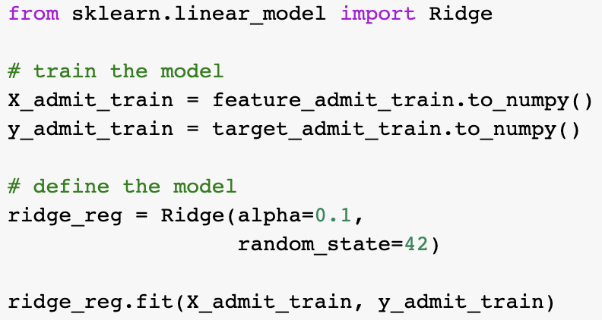
Training the Model
Excluding gre_score and toefl_score
This one is lambda
For lasso, only need to change Ridge to Lasso

Slide 39
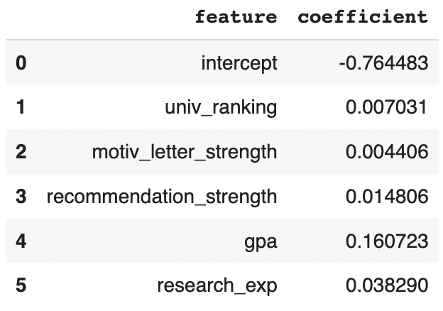
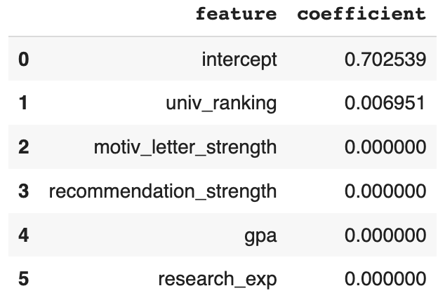
Comparing the Coefficients
Ridge
Lasso
exactly zero

Slide 40


Hands-On
Open today’s Jupyter notebook on your Google Colab!
Make sure you have uploaded the required CSV files to your google drive
Remember the file path!

Slide 41
Comparing the Coefficients
Ridge
Lasso
exactly zero
But...
How to select the best lambda?

Slide 42
1
Split data: train - validate - test
80% → 80% training vs 20% validation
20% testing
2
Multicollinearity check
Calculate VIF score for each feature
Correlation analysis to drop redundant feature
3
Fit multiple models on training data
Modeling Flow:
Regularized Regression
(with choosing lambda)
Train multiple models with different lambdas (alpha)
Only include retained features from step 2
4
Choose the best lambda from validation set
The one with the smallest RMSE
5
Model diagnostic
Residual plot, R2 score on training data
6
Evaluate the model on test data
RMSE
MAE
MAPE
New for today
New for today

Slide 43
Split the Data
We now have three data: train-validation-test
First, split the data into pre-train and testing (80:20)
Using train_test_split(feature, target)
Next, split pre-train data into train and validation (80:20)
Using train_test_split(feature_pretrain, target_pretrain)

Slide 44
Feature Correlation
To prevent multicollinearity
Same as previously, will drop:
gre_score
toefl_score

Slide 45
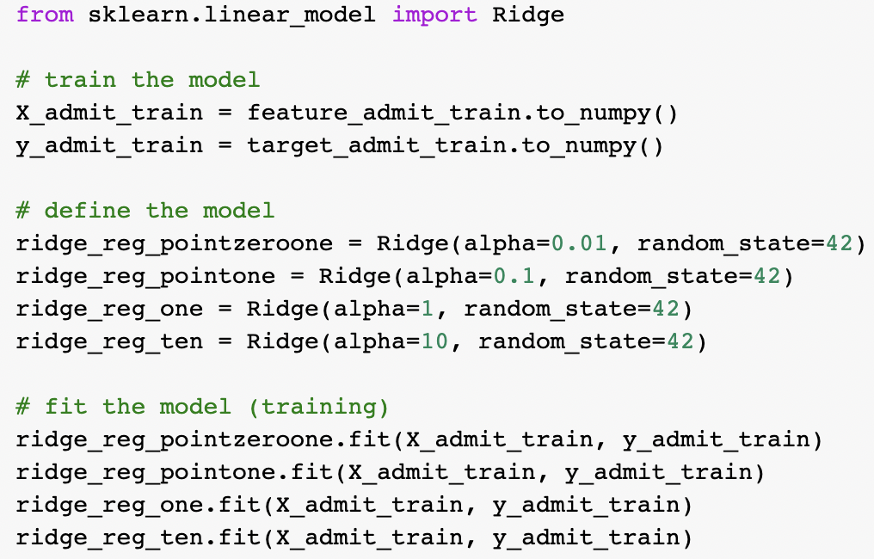
Train Multiple Models
Lambda (alpha) in [0.01, 0.1, 1, 10]

Slide 46
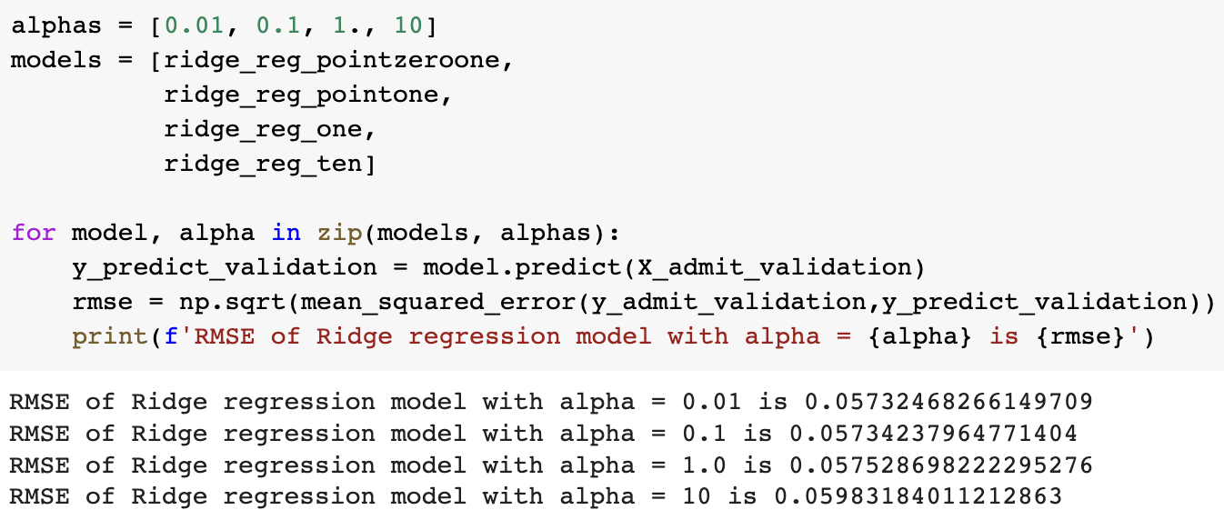
Choosing the Best Lambda
Using validation data
The best lambda is 0.01

Slide 47
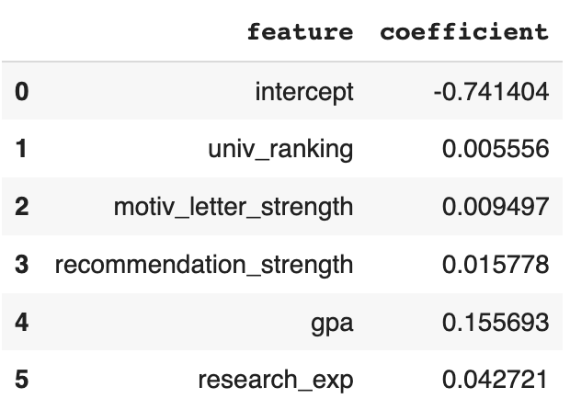
Interpreting the Best Model
Best model == model with the best lambda
admit_prob = -0.741 +
0.005 uni_rank + 0.009 motiv +
0.015 recom + 0.155 gpa +
0.042 research
Interpretation?

Slide 48
Hands-On
Open today’s Jupyter notebook on your Google Colab!
Make sure you have uploaded the required CSV files to your google drive
Remember the file path!

Slide 49


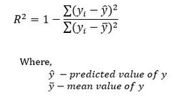
Evaluasi: MAE, RMSE, R²
Mean Absolute Error (MAE): mengukur rata-rata error dari hasil prediksi tanpa memperhitungkan arah (semakin kecil semakin baik)
Root mean squared error (RMSE): adalah aturan penilaian kuadrat yang juga mengukur besarnya rata-rata kesalahan.
R²: berkisar antara 0-1, mengindikasikan seberapa besar variabel independen mempengaruhi variabel dependen. semakin mendekati angka 1, model semakin baik.

Slide 50
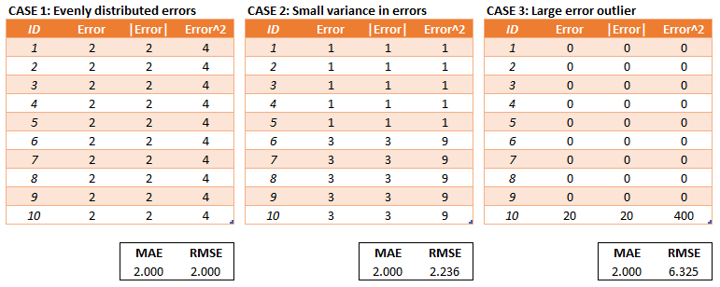
Kapan menggunakan MAE/RMSE?
RMSE mempunyai keuntungan dengan memberikan penalti error yang besar, sehingga menghasilkan pengukuran yang tepat untuk beberapa kasus yang lebih sensitif

Slide 51
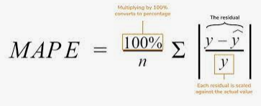
Model Evaluation
Mean absolute percentage error (MAPE)
How far in relative percentage basis is the model’s prediction relative to the actual data on average

Slide 52
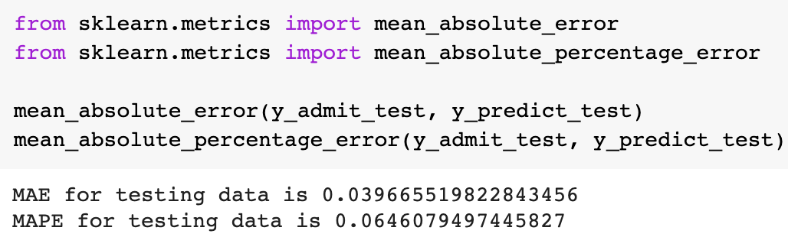
Model Evaluation (2/2)
MAE = 0.040
On average, our prediction deviates the true admit_prob by 0.040
MAPE = 0.065 = 6.5%
Moreover, this 0.040 is equivalent to 6.5% deviation relative to the true admit_prob

Slide 53
When to Use:
Ridge vs LASSO
01
02
Ridge
LASSO
Only make the coefficients small, NOT zero
Works well if there are many large parameters of about the same value
Can set some coefficients to zero
Thus performing variable selection
Tends to do well if there are a small number of significant parameters and the others are close to zero
That said, ridge and LASSO oftentimes perform similarly, just train both and choose the best!

Slide 55
Hands-On
Open today’s Jupyter notebook on your Google Colab!
Make sure you have uploaded the required CSV files to your google drive
Remember the file path!

Slide 56

Assignment
What to submit? Google colab/kaggle link (MANDATORY) (don’t forget to share access to me: arifromadhan19@gmail.com)
Format notebook name: HW_REGRESSION_<YOUR COMPLETE NAME>

Slide 57
Assignment
The Data Used
For the assignment, we will use the following data
Download link
The data is about predicting housing price (medv) in Boston city, features:
Criminal rate (crim)
Residential land zoned proportion (zn)
Non-retail business acres proportion (indus)
Is bounds with river (chas)
Nitrogen oxides concentration (nox)
Number rooms average (rm)
Owner age proportion (age)
Weighted distance to cities (dis)
Accessibility index (rad)
Tax rate (tax)
Pupil-teacher ratio (ptratio)
Black proportion (black)
Percent lower status (lstat)

Slide 58
Assignment
Instructions
Split data: train - validate - test (point: 10)
Draw correlation plot on training data and perform feature selection on highly correlated features (point: 10)
Fit models on training data (lambdas = [0.01, 0.1, 1, 10]) (point:50)
Ridge regression (point: 25)
LASSO (point: 25)
Choose the best lambda from the validation set (point: 20)
Use RMSE & MAE as metric
Interpret a sample of the coefficients of the best model
Ridge regression
LASSO
Evaluate the best models on the test data (+ interpretation) (point: 10)
MAE
MAPE
RMSE
R2

Slide 59
Thank you

Slide 60
Appendix

Slide 61
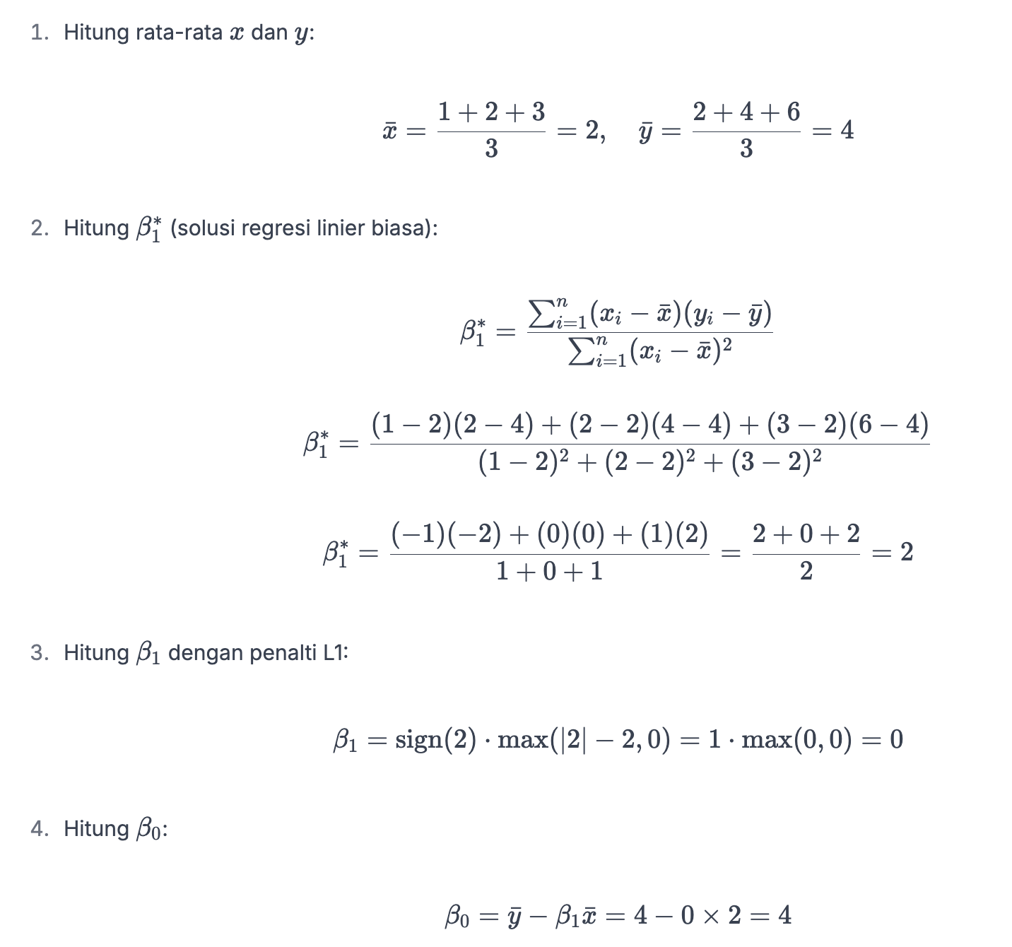
Lasso Detail Formula

Slide 62
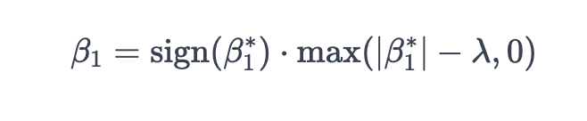
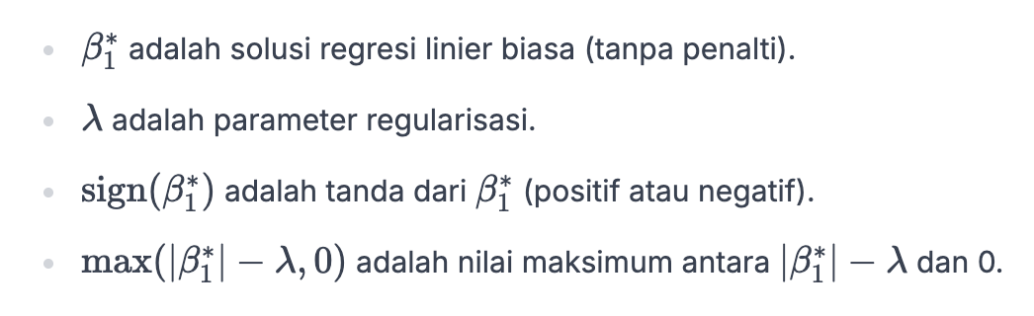
L1 Lasso Detail Formula

Slide 63
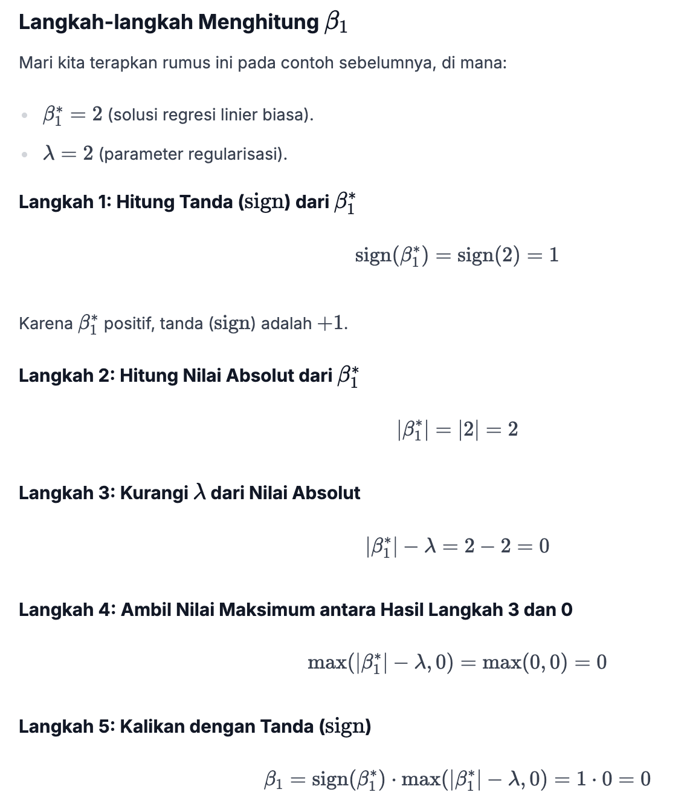
L1 Lasso
Step by Step

